Slide 1

Binary Search Trees: Balance
Saif Hassan
Department of Computer Science
Sukkur IBA University
Data Structures
Data Structures and Algorithms

Slide 2
Agenda
Runtime
Balanced Trees

Slide 3
Learning Objectives
Think about the runtime of basic binary tree operations.
Understand the motivation behind binary search tree balance.

Slide 4
Agenda
Runtime
Balanced Trees

Slide 5
Runtime
How long do Binary Search Tree operations take?

Slide 6
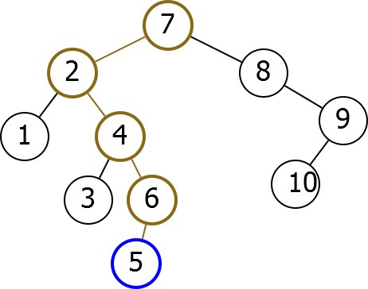
Find
Find(5)
Number of operations = O(Depth)

Slide 7
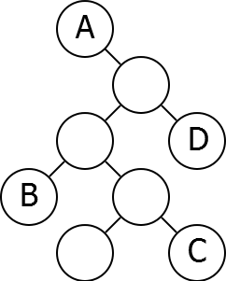
Problem
Which nodes will be faster to search for in the following tree?

Slide 8
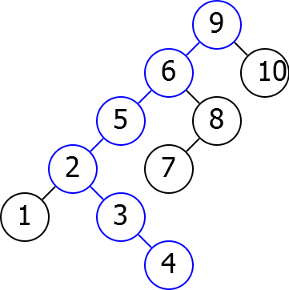
Example I
Depth can be as bad as n.

Slide 9
Agenda
Runtime
Balanced Trees

Slide 10
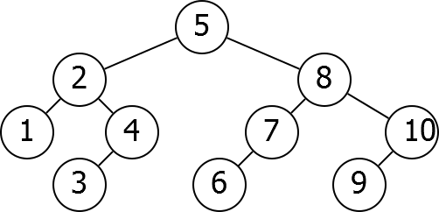
Example II
Depth can be much smaller.

Slide 11
Balance
Want left and right subtrees to have approximately the same size.

Slide 12
Balance
Want left and right subtrees to have approximately the same size.
Suppose perfectly balanced:
Notes:
And this is what we mean by balance.
And if you're balanced, suppose that you're perfectly balanced,
everything is exactly the same size,

Slide 13
Balance
Want left and right subtrees to have approximately the same size.
Suppose perfectly balanced:
Each subtree half the size of its parent. After log₂(n) levels, subtree of size 1.
Operations run in O(log(n)) time.
Notes:
then this is really good for us.
Because it means that each subtree has half the size
of sort of the subtree of its parent.
And that means after you go down, logarithmically,
many levels the subtrees have size one and you're just done.
And so, if your tree is well balanced, operations should run in O(log(n)) time,
which is really what we want.

Slide 14

Problem
Insertions and deletions can destroy balance!

Slide 15
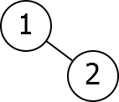
Problem
Insertions and deletions can destroy balance!

Slide 16
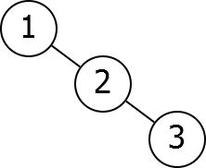
Problem
Insertions and deletions can destroy balance!

Slide 17
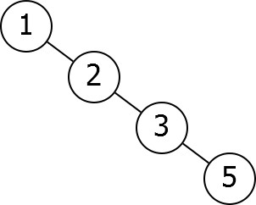
Problem
Insertions and deletions can destroy balance!

Slide 18
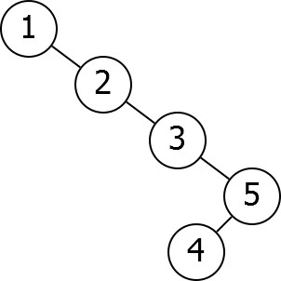
Problem
Insertions and deletions can destroy balance!
Notes:
you'll note that suddenly we've got a very, very unbalanced tree.
But all we did were updates.
So, somehow we need a way to get around this.
We need a way to do updates without unbalancing the tree.

Slide 19
Rebalancing
Idea: Rearrange tree to maintain balance.
Notes:
And the basic idea for how we're going to do this, is we're going to want to have
some mechanism by which we can rearrange the trees in order to maintain balance.

Slide 20
Rebalancing
Idea: Rearrange tree to maintain balance.
Problem: How do we rearrange tree while maintaining order?
Notes:
And there's one problem with this, which is that however we rearrange the tree,
we have to maintain the sorting property.
We have to make sure that it's still sorting correctly or
none of our other operations will work.
And well, there's a key way to do this, and this is what's known as rotation.

Slide 21
Next Time
How to keep a tree balanced. AVL trees.
Notes:
Talk about how to keep tree balanced

